Slide 1





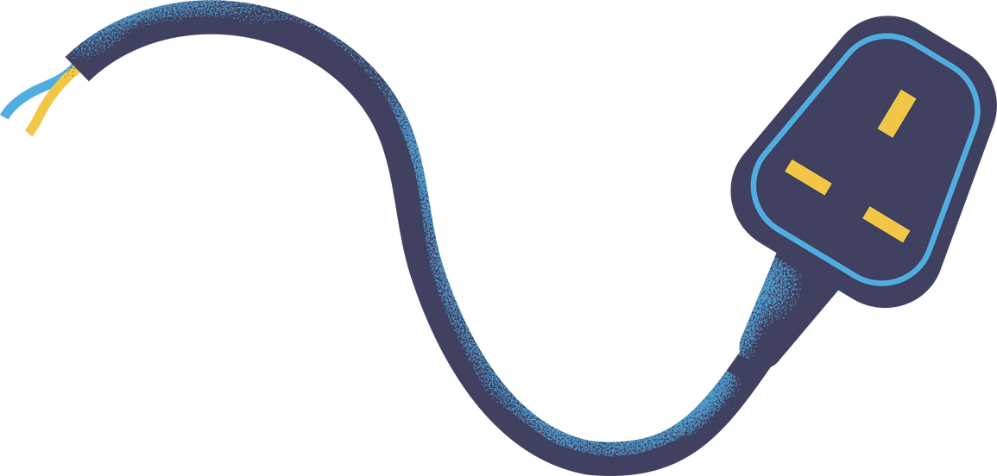

Automatic Vacuum Cleaner Robot Project
Exploring the components of a circuit

Slide 2

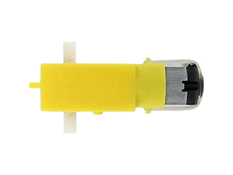
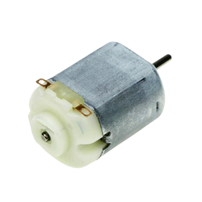
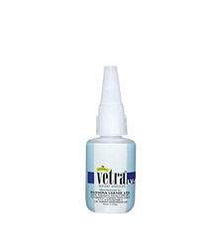
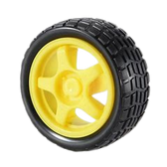
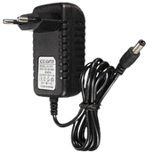
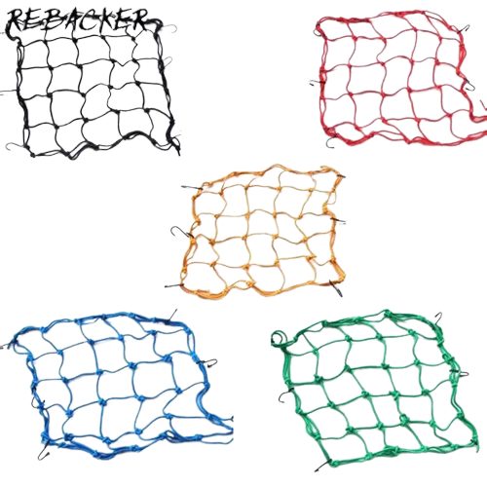


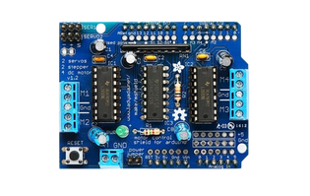
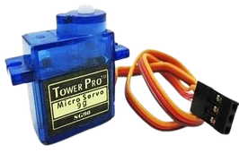
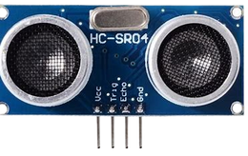
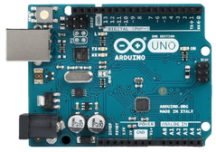
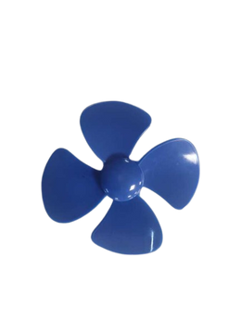
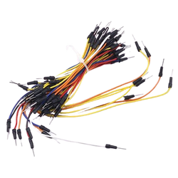
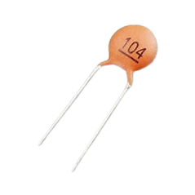
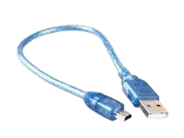
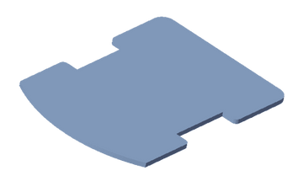
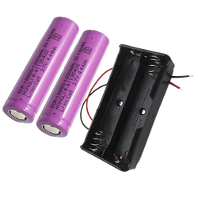
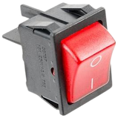
List of Components
Wire cutter: 1
Vetra Glue: 1
Wheels: 4
Dual Shaft Motor: 4
AC to DC Power supply: 2V
DC Motor: 1
3-6V
Mesh: 1
Plastic bottle: 1
Cessor:1
Arduino UNO:1
Arduino Shield:1
Servo motor: 1
Ultrasonic sensor: 1
Ice cream
Stick: 2
Base plate: 1
single strand wire
Lithium Battery
9V
Capacitor : 1
100nF
DC Motor Fan: 1
ON - OFF
Switch: 1
Arduino Data
Cable: 1

Slide 3
Component Assembly

Slide 4





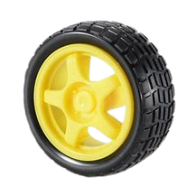
Step 1.
connect motor to
each wheel
Component List Used in Assembly

Slide 5

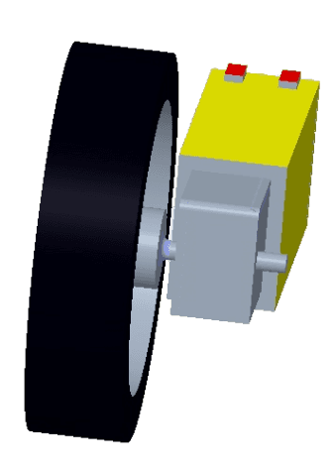
Step 2.
connect the wheels
to all 4 motors
Component List Used in Assembly
Component List Used in Assembly

Slide 6

Step 3.
Solder single strand wires on all 4 motors leaving one end of wire soldered and other end open.
Component List Used in Assembly

Slide 7
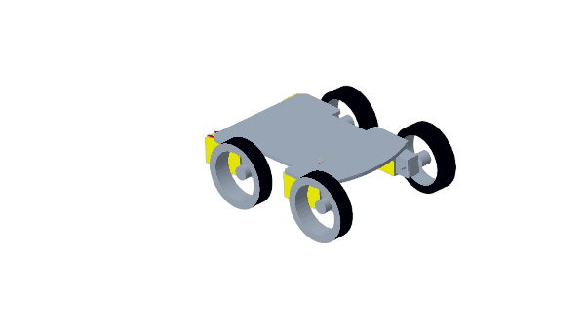

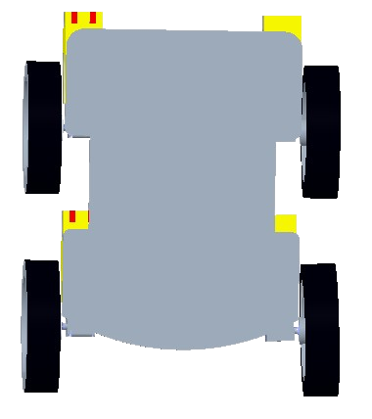
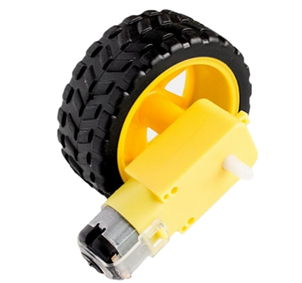
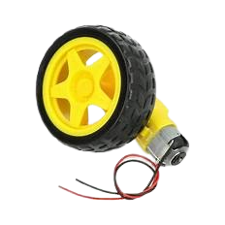
Step 4.
Use Hot glue to connect all the 4 motors to the base of acrylic sheets
Component List Used in Assembly

Slide 8

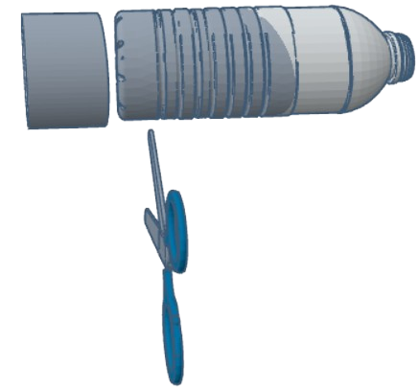
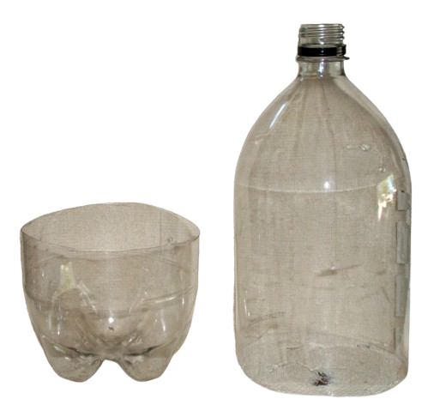
Step 5.
Cut a plastic bottle as shown in image.
Component List Used in Assembly

Slide 9

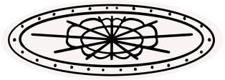
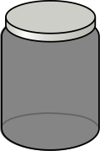

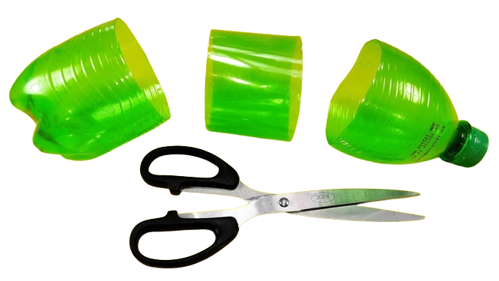
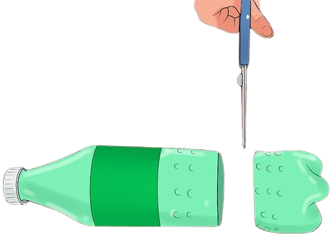
Step 6.
From part 2 of bottle cut another small cylinder part and cover it with mesh as shown
Component List Used in Assembly
1 2

Slide 10

Step 7.
Now insert this part from (step 6) to part 1 as shown.
Component List Used in Assembly
1 2

Slide 11
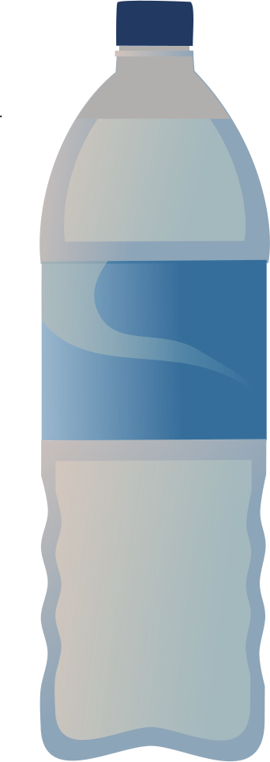
Step 8.
After inserting the mesh in the bottle it will look similar to this.
Component List Used in Assembly

Slide 12

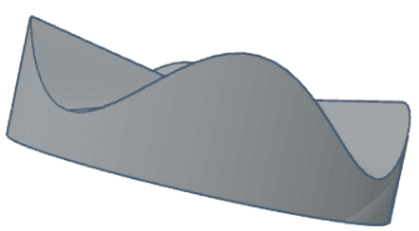

Step 9.
Use part 2 from (step 5) to make to slots as shown in fig. Make 2 on both on opposite ends
Component List Used in Assembly

Slide 13
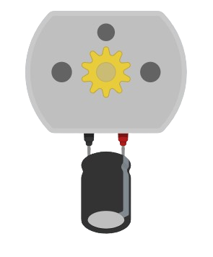

Step 10.
Solder single strand wires on DC Toy / Hobby Motor and on the same two points solder capacitor (104uF).
Component List Used in Assembly

Slide 14
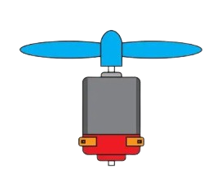

Step 11.
Place the hobby motor in between the thin wooden sticks using hot glue and then connect the fan to this motor.
Component List Used in Assembly

Slide 15

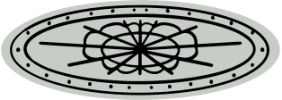
Step 12.
use the hot glue to mount the DC motor on the bottle.
Component List Used in Assembly

Slide 16
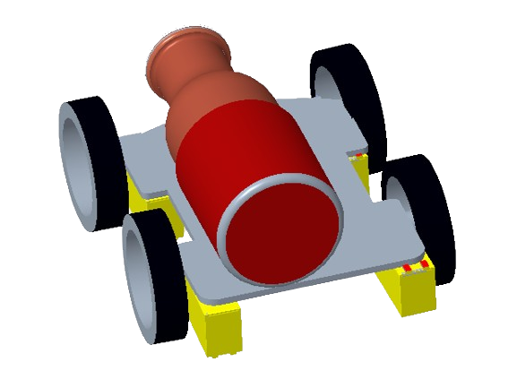

Step 13.
Now mount the plastic bottle on top of the acrylic sheet using hot glue.
Component List Used in Assembly

Slide 17
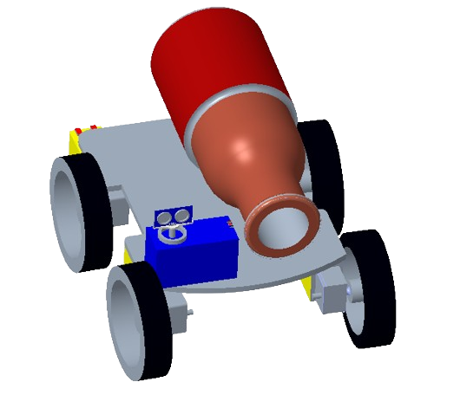

Step 14.
Now beside the front end of bottle mount the servo motor using hot glue. And then connect another ARM on top of it using hot glue
Component List Used in Assembly

Slide 18

Step 15.
On top of the ARM mount the Ultrasonic sensor using Hot Glue.
Component List Used in Assembly

Slide 19
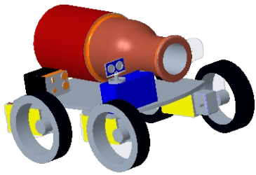

Step 16.
At the back side attach the batteries and power switch using Hot Glue.
Component List Used in Assembly

Slide 20
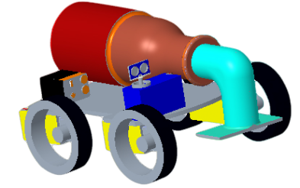
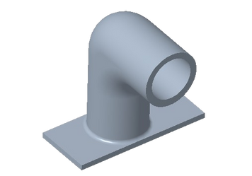
Step 17.
Connect the other pipe section to the bottle.
Component List Used in Assembly

Slide 21
Circuit Connection

Slide 22
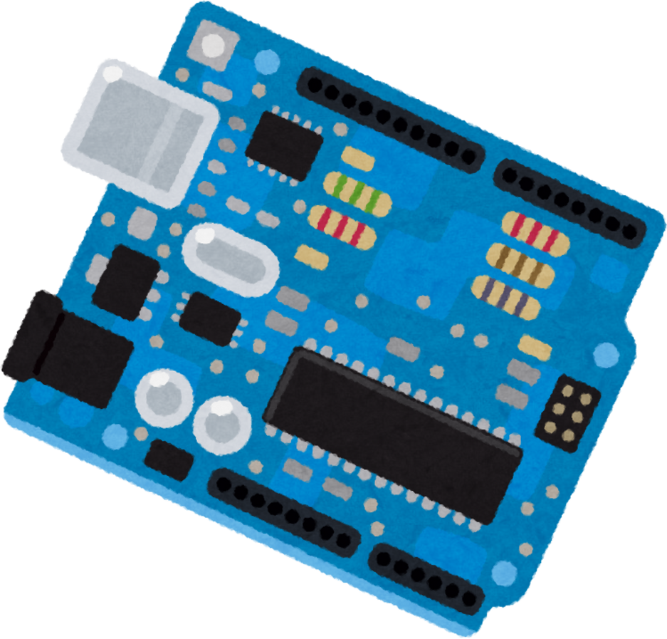
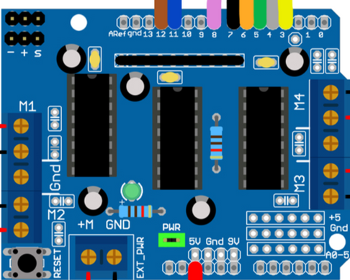
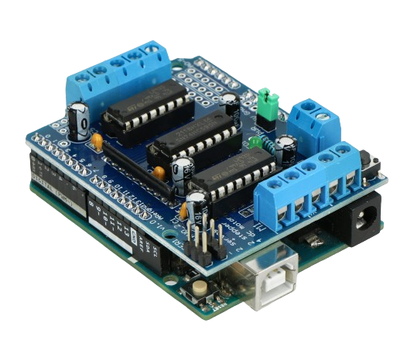
Step 18.
Place the Motor shield drive on top of the Arduino Uno.
Looks like this
Component List Used in Assembly

Slide 23

Step 19.
Connect the other end DC motor (Connected to wheels) to the motor shield drive on location (Motor 1, Motor 2, Motor 3, Motor 4) as shown in above figure.
+
-
+
-
+
-
M1
M2
+
-
Motor 1
Motor 3
+
-
M3
M4
+
-
Component List Used in Assembly
+
-
+
-
Arduino Shield
Motor 2
Motor 4

Slide 24
Step 20.
connect 1 servo motor to the motor shield drive on location (servo1) as shown in above figure.
Servo brown wire a ground pin(S)
Servo red wirepluspin(+)
Servo yellow wire à negative pin (-)
Vcc
Pin
Gnd
Vcc
Pin
Gnd
Component List Used in Assembly
Servo Motor
Arduino
shield

Slide 25

Step 21.
connect the 1 Ultrasonic sensor to the motor shield drive on location (5V, GND, A0 to trig and A1 to echo ) as shown in above figure.
Vcc
Pin
Gnd
Servo motor
Vcc
Pin
Gnd
Vcc
A0
A1
Gnd
Arduino
Shield
Vcc
Trig
Echo
Gnd
Component List Used in Assembly
Ultrasonic sensor

Slide 26

Step 22.
Connect the batteries to the output of these switches to (+9/12V) pins of he motor shield drive.
+
-
Vcc
Pin
Gnd
Battery
Vcc Gnd
Servo motor
Vcc
Pin
Gnd
Vcc
A0
A1
Gnd
Arduino
Shield
Vcc
Trig
Echo
Gnd
Component List Used in Assembly
Ultrasonic sensor

Slide 27
Step 23.
Final circuit
+
-
+
-
Motor 1
+
-
M1
M2
+
-
Motor 3
+
S
-
Vcc
A0
A1
Gnd
Arduino
Shield
Vcc
Pin
Gnd
Vcc
Trig
Echo
Gnd
Servo motor
+
-
+
-
M3
M4
Ultrasonic sensor
Vcc Gnd
+
-
Vcc Gnd
Vcc Gnd
+
-
Motor 2
Battery
Switch
Motor 4

Slide 28
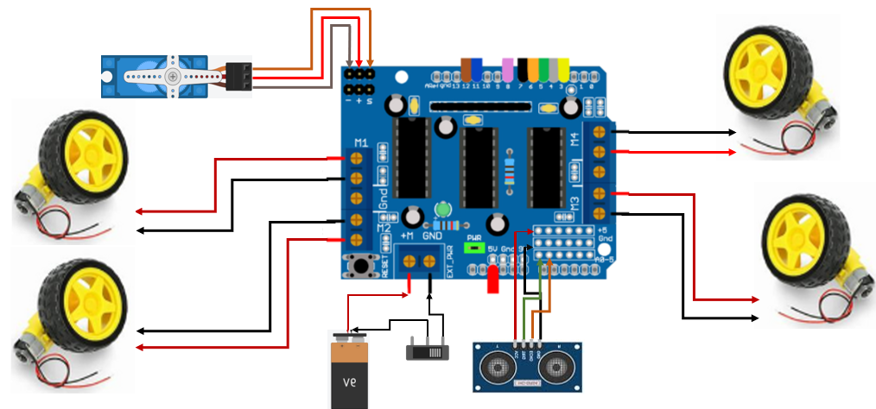
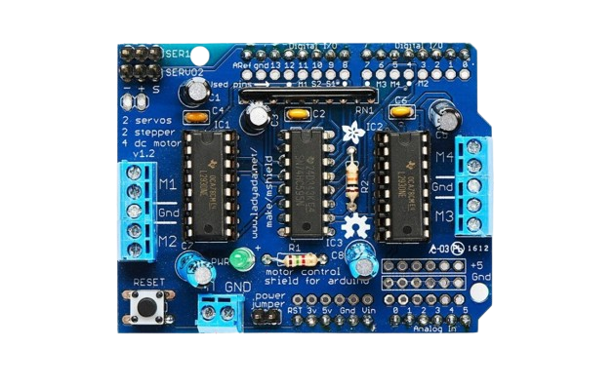
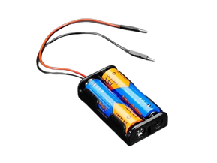
Step 24.
Final circuit

Slide 29
Programming

Slide 30


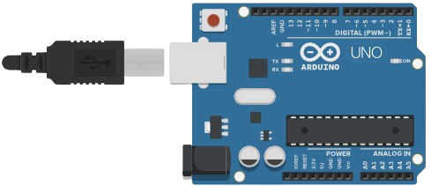
Step 25.
Connect the data cable to Arduino and your laptop.
Open the Arduino IDE app.
Component List Used in Assembly

Slide 31
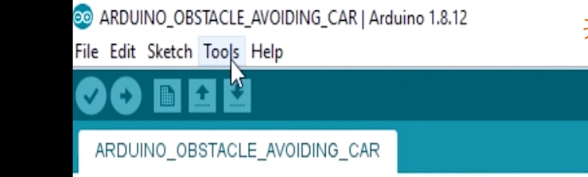
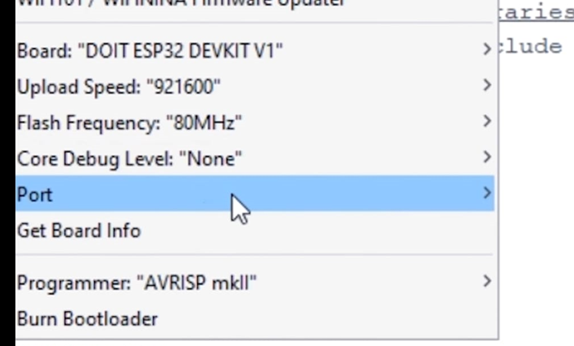
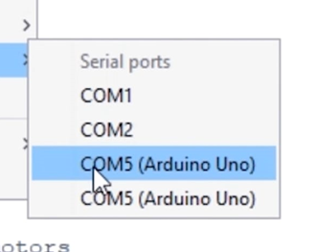
Step 26.
Open the source code given for this project.
Go to “Tools” → “Port” → connect to the port you have connected the Arduino. Example( COM5)

Slide 32


Step 27.
Go to ‘Tools” → “Board” → select “Arduino Uno”

Slide 33


Step 28.
Go to ‘Tools” → “Programmer “ → select “AVRISP mkll”

Slide 34


Step 29.
Dump the code by selecting the arrow button on top left corner.
After uploading, remove the data cable from the Arduino.
Arduino

